Slide 1
A Data-driven Analysis of Animal-related Electric Outages using Species Distribution Models of Bird Abundances

Slide 2
Knowledge Gaps in Animal-Outage studies
Goals and Objectives
Lack of available animal abundance data
Use proxies of activity from animal-outage reports
or aggregate abundance across species
Limited to a few focal species and regions
Variation indicates need for more studies across diverse species and regions
Introduce an ecological data resource for animal-outage studies → community science databases such as eBird
Global database with year-round observations
Demonstrate how species distribution models (SDMs) can extrapolate relative abundance estimates for many species across flexible spatial and time scales.
Visualize how animal-outages are spread across diverse species

Slide 3
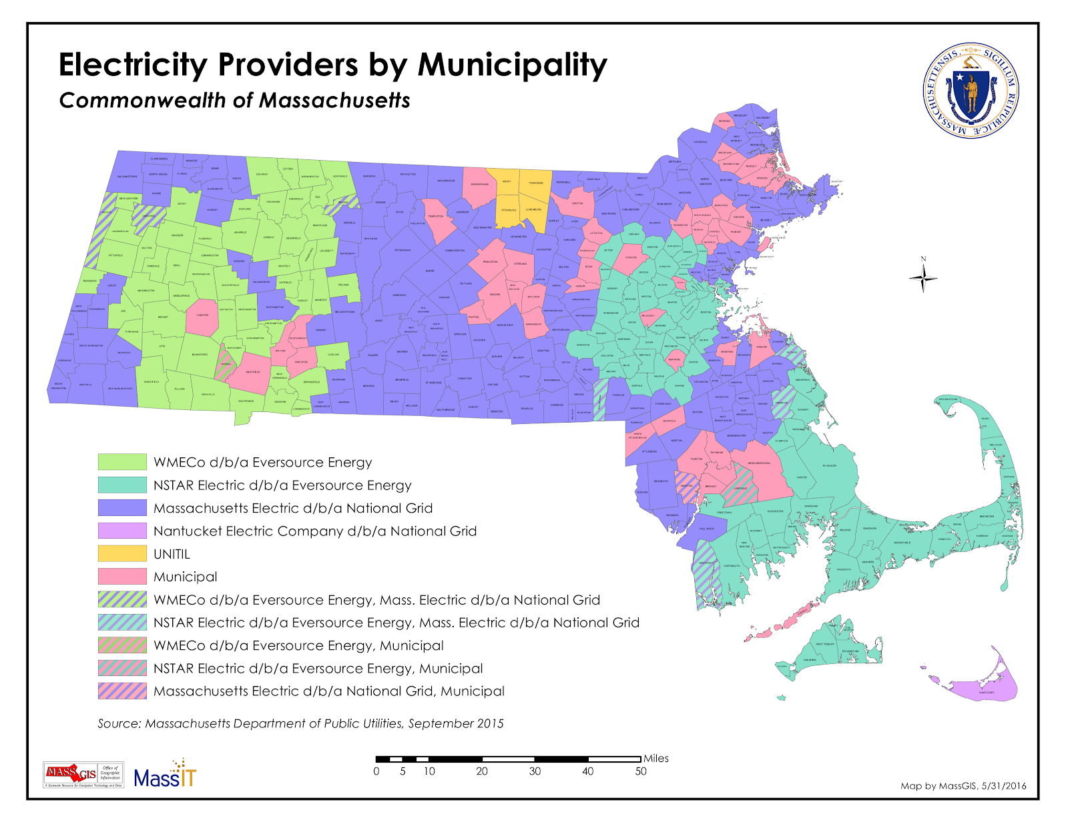
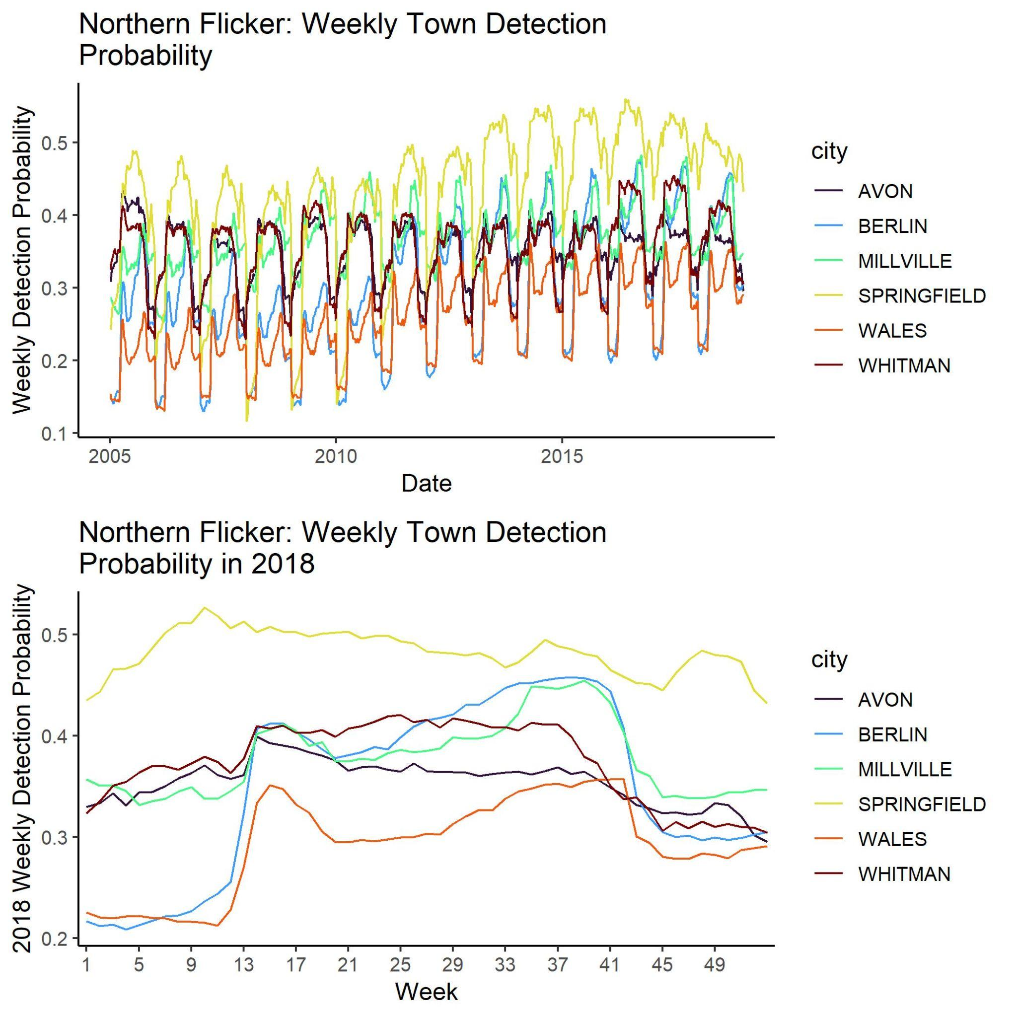
Data
Outage Data
MA outage data from 2013 - 2018
Three major utilities (shown beside)
City level spatial resolution
Minute level temporal resolution aggregated to weekly
Preprocessing
Verification
Correct missing values, outliers
e-Bird Data
MA bird observations from 2013-2018
14 focal species
Minute level, lat/long observations
SDM relative abundance
Weekly, city resolution estimates
Relative abundance is detection probability
Random forest SDM approach

Slide 4
Findings
Outage-prone bird species occupy different spatial distributions and temporal patterns in activity.
Bird-related outages are spread evenly across all 14 species’ spatio-temporal patterns
Models accounting for activity in multiple focal species out perform models using only one species or species aggregates
Urban-rural disparity is evident using data on habitat characteristics and AROs

Slide 5
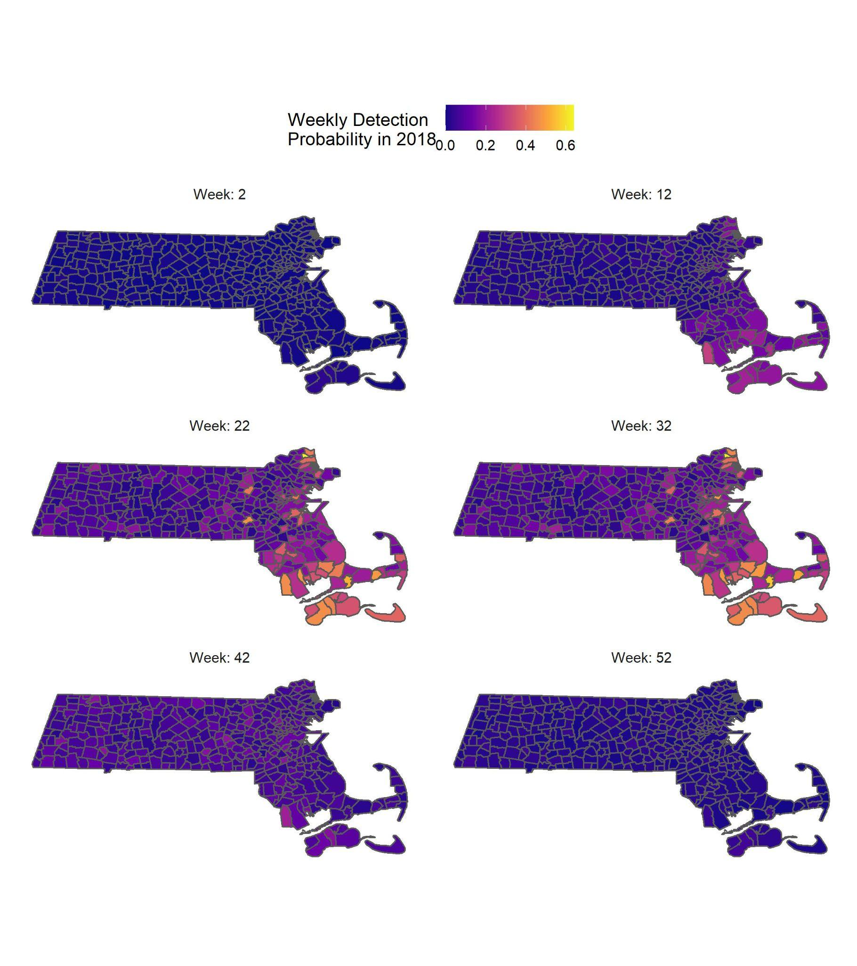
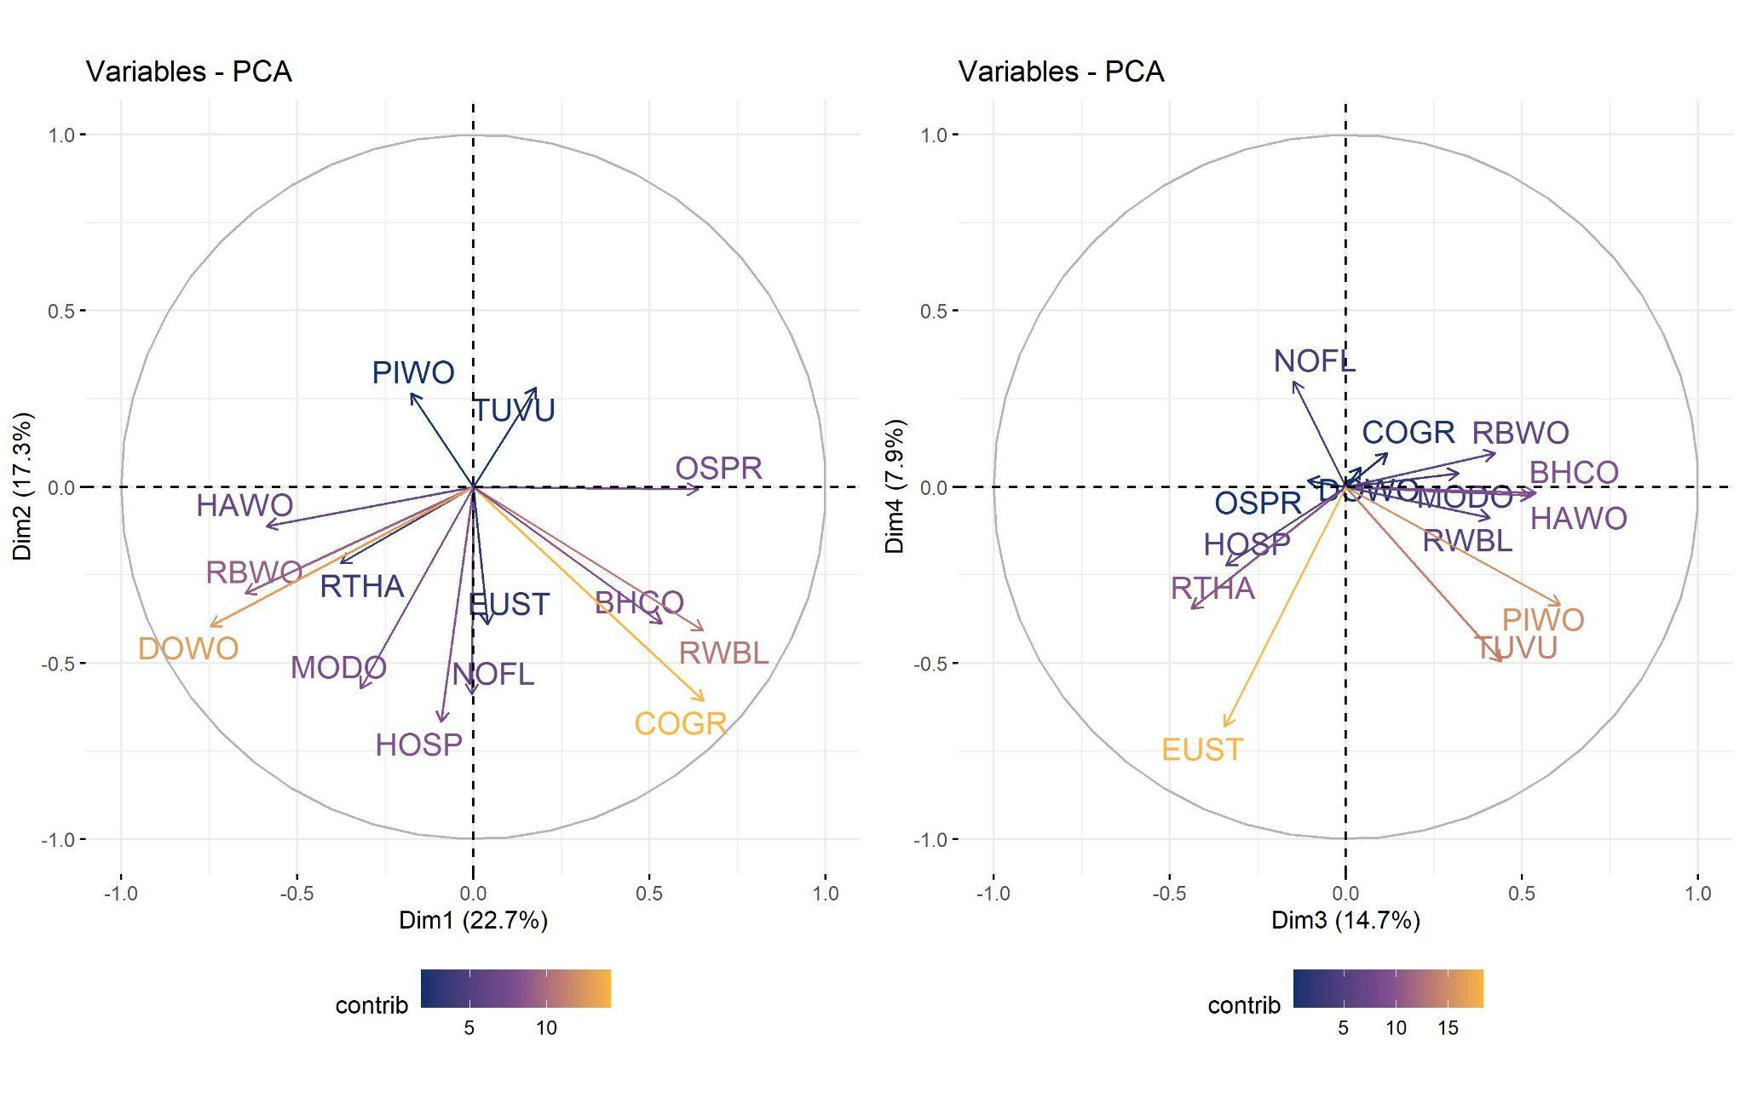
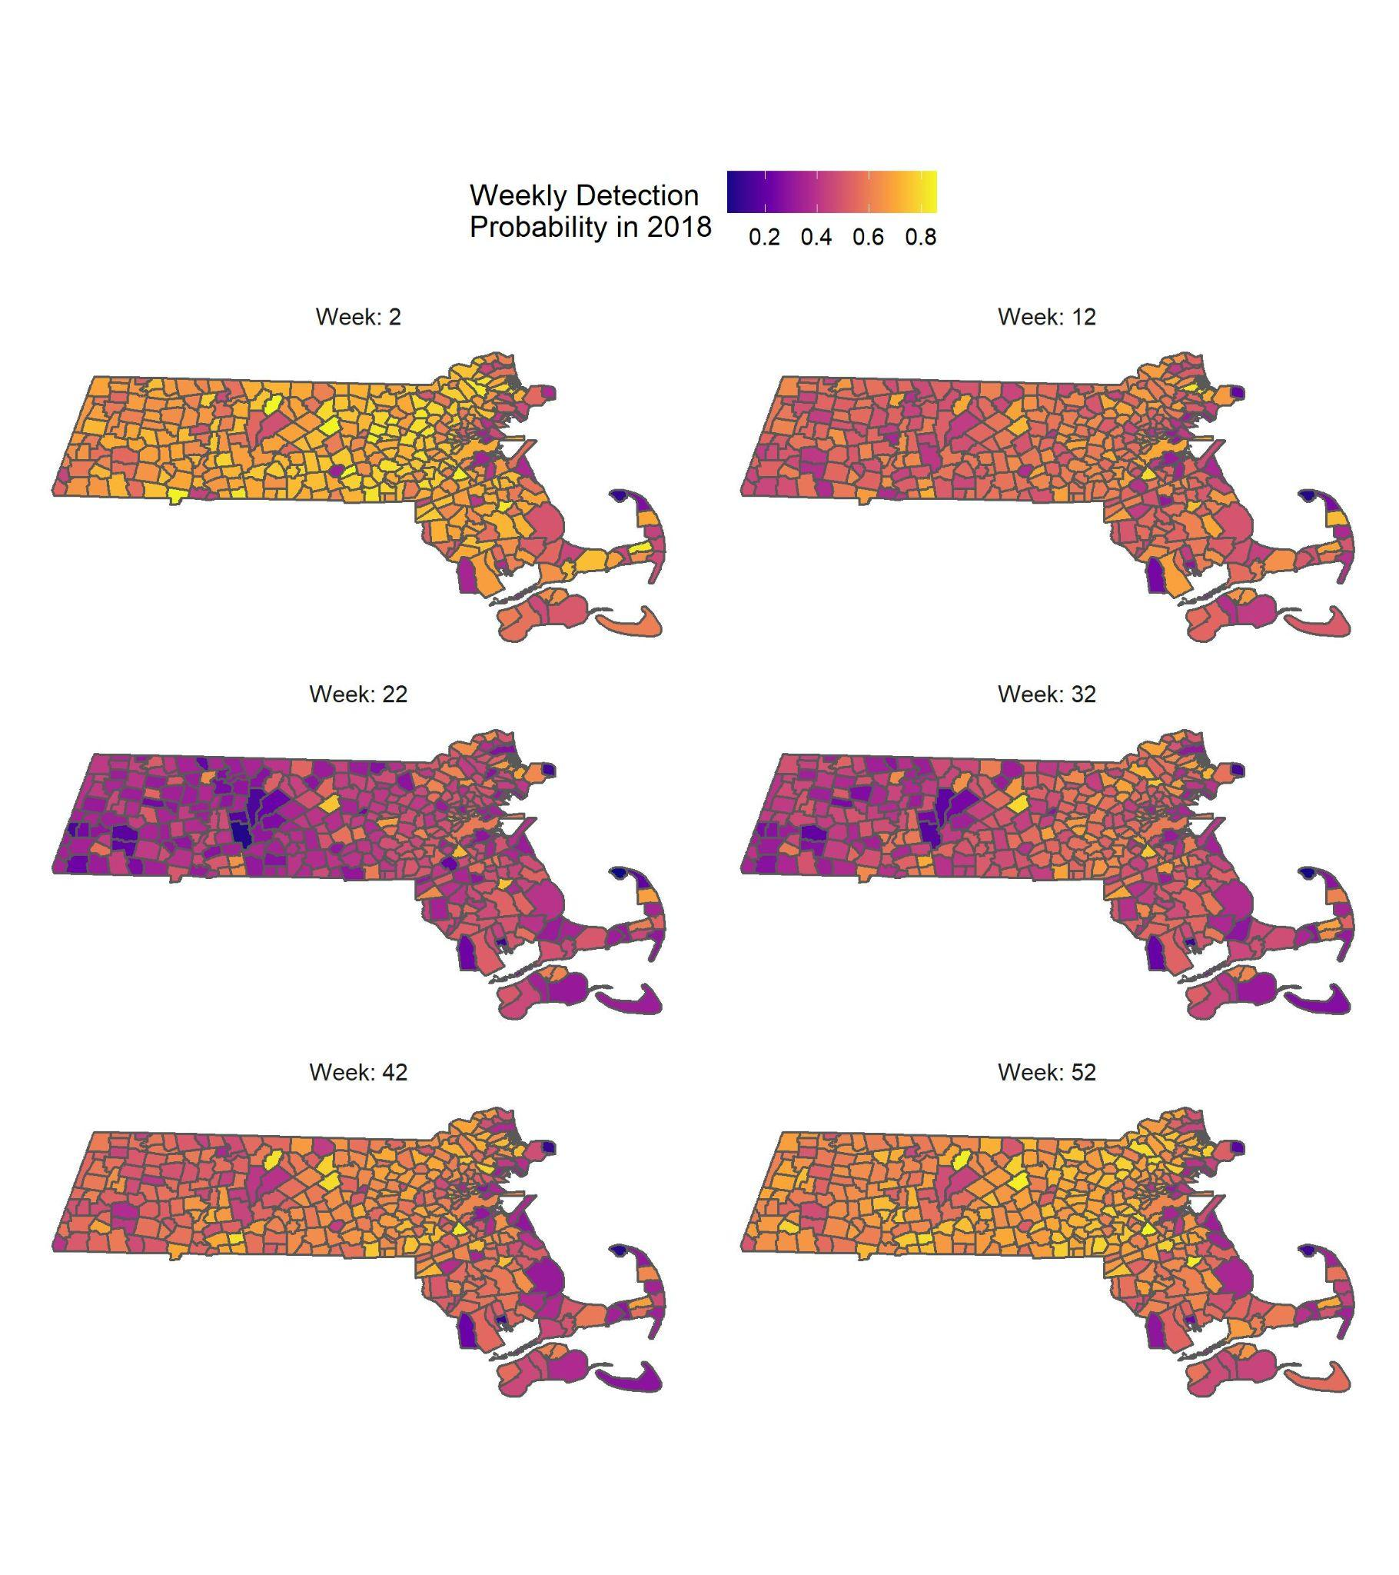
1. Outage-prone bird species occupy different spatial distributions and temporal patterns in activity.
Axes are PC loading vectors for each species. PCs 1-4 are shown.

Slide 6
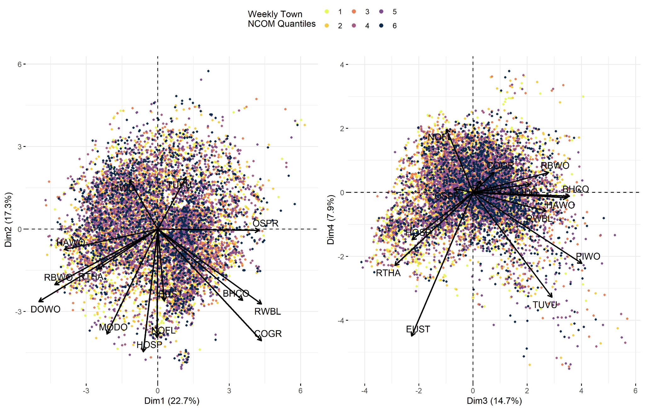
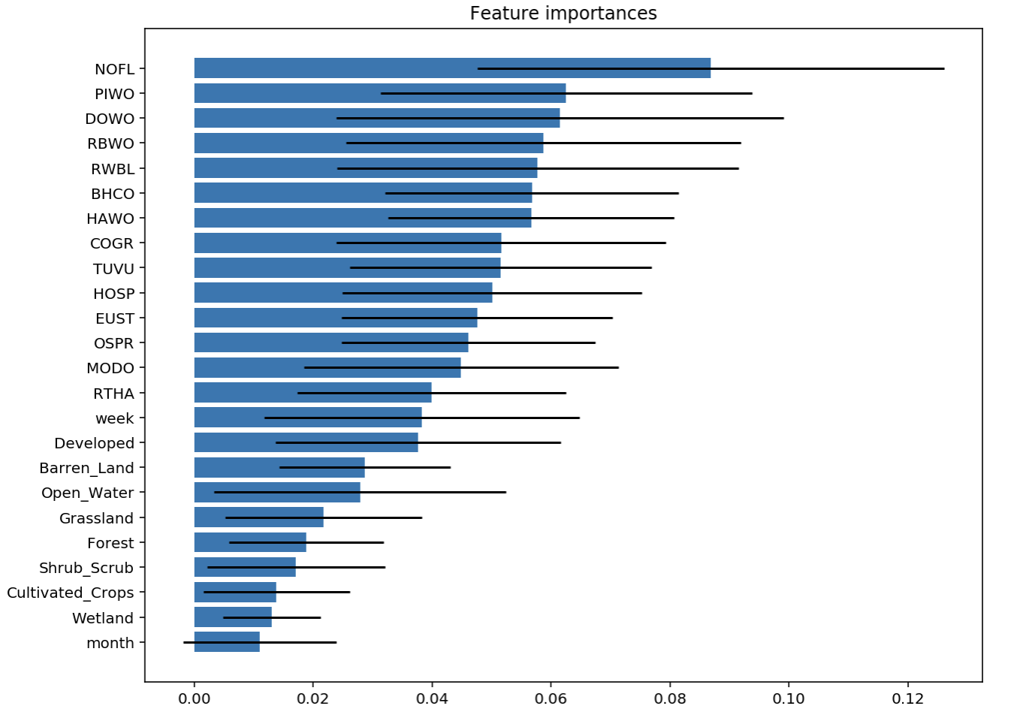
2. Bird-related outages are spread evenly across all 14 species’ spatio-temporal patterns
PCA of bird species abundance. Weekly-town outage observations are dispersed across all species loading vectors
Importance of 14 focal species, time, and land cover type in a random forest model of animal-outages.

Slide 7
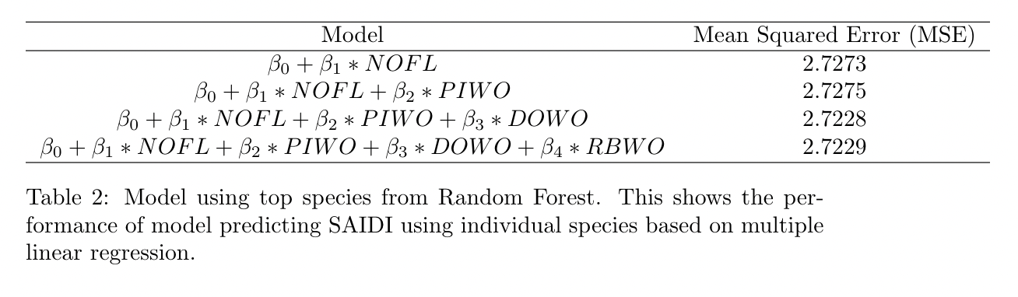
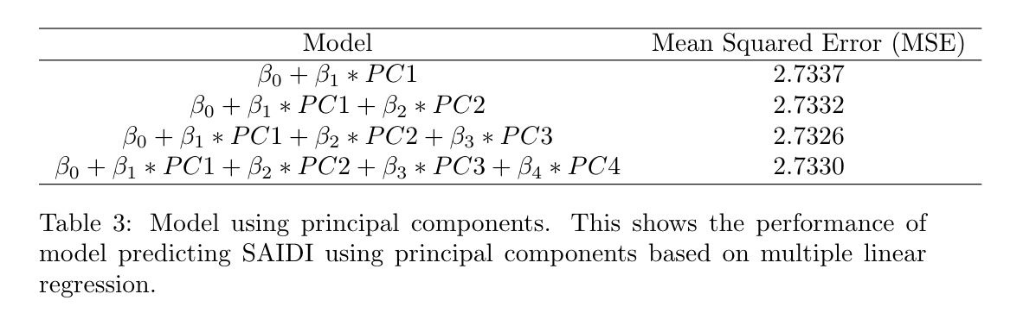
3. Models accounting for activity in multiple focal species out perform models using only one species or species aggregates

Slide 8
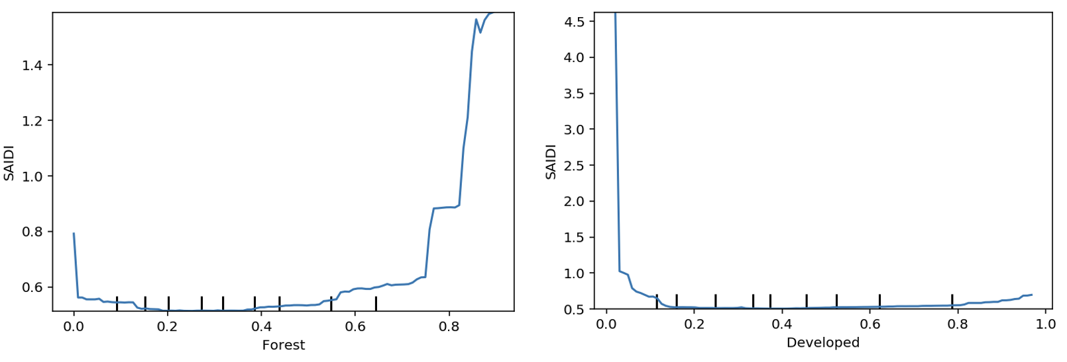
4. Urban-rural disparity is evident using data on habitat characteristics and AROs
Forested habitat=more outages, contrasts previous literature which find the lack of habitat in open/urban areas force animals to use electrical equipment more frequently
Notes:
Hypothesis: forested areas have greater animal density. Or bird species with the greatest impact on distribution lines depend on forested habitat.

Slide 9
Conclusions
Community science data (such as eBird) is a resource for ecological data in animal-outage studies
eBird combined with SDMs allows improves the accessibility of animal activity data, allowing these studies to be expanded across more diverse regions and species.
Expanding these studies will allow us to capture greater variation in the animal-outage relationship
Accounting for species-level ecology will better allow species and grid managers to mitigate impacts on populations and distribution reliability.
Better understand the mechanisms driving animal-outages

Slide 10
Next Steps
Target journals:
People and Nature https://besjournals.onlinelibrary.wiley.com/hub/journal/25758314/aims-and-scope/read-full-aims-and-scope
Reliability, Engineering, and Systems Safety https://www.elsevier.com/journals/reliability-engineering-and-system-safety/0951-8320/guide-for-authors
Deadlines
Nov 15 [Final Draft]

